Slide 1
Problem Statement
Innovative Monitoring System for TeleICU Patients Using Video Processing and Deep Learning

Slide 2
Unique Idea Brief (Solution)
Introduction:
The Intensive Care Unit (ICU) is a specialized section of a hospital where critically ill patients receive comprehensive and continuous care. However, the high patient-to-nurse ratio, the need for constant monitoring, and the potential for rapid deterioration in patient conditions necessitate the adoption of advanced monitoring solutions. Traditional methods rely heavily on physical presence and manual observation, which can be resource-intensive and prone to human error.
The integration of TeleICU systems aims to mitigate these challenges by utilizing video cameras and deep learning models to monitor patient activities, identify potential emergencies, and alert healthcare professionals promptly. This approach not only enhances the efficiency of ICU operations but also ensures that patients receive the necessary attention without delay.

Slide 3
Brief Solution
Step1: Data Acquisition and Preprocessing
Take Video as Dataset: Obtain video footage from ICU season from YouTube.
Read and Convert Video to Images:
Use OpenCV to read the video.
Convert the video into images, saving every alternate frame (.jpg or .png).
Step2: Image Annotation and Clustering
Image Annotation with CVAT Tool: Annotate the images to label individuals.
K-Means Clustering:
Cluster1: Patient
Cluster2: Doctor or Nurse
Cluster3: Family Members

Slide 4
Step3: Model Development and Deployment
Split the Model into 3 Models for Fast Response:
Model 1 (YOLOv8, COCO Dataset): Detect and classify the types of people in the TeleICU (Patient, Doctor/Nurse, Family Members).
Model 2 (Activated if Model 1 detects the patient is alone or with family members): Determine if there is any patient movement (Yes/No).
Model 3 (Activated if Model 2 detects movement): Identify the type of patient movement.
Breathlessness (patient’s mouth widely open and head moving)
Hands and legs movement
Falling from the bed
Trying to wake up
Step4: Training and Execution
Train Models Using Lightweight Models:
Use SSD and MobileNet for efficient and fast training.
Step5: Performance Evaluation
Calculate Accuracy: Evaluate the performance and accuracy of the models in detecting and classifying activities and individuals.

Slide 5
Features Offered
Real-Time Surveillance
Continuous monitoring of ICU patients via video feeds.
Real-time analysis and alert generation to ensure timely medical intervention.
Automated Classification
Utilizes deep learning models (YOLOv8) for detecting and classifying individuals in the ICU.
Categories include patients, doctors/nurses, and family members, enabling context-specific monitoring.
Activity Detection
Specialized models (e.g., SSD, MobileNet) detect and classify patient activities.
Identifies critical movements such as breathlessness, limb movement, falls, and attempts to get up.
Video Processing with OpenCV
Efficiently converts video streams into image frames for analysis
Saves every alternate frame to ensure comprehensive monitoring without excessive data processing.

Slide 6
K-Means Clustering for Image Annotation
Implements k-means clustering with k=3 to annotate images.
Clusters images into three categories: patients, doctors/nurses, and family members for accurate detection.
Google Colab Integration
Utilizes Google Colab for model training and execution.
Accesses and saves data directly from and to Google Drive, ensuring seamless data management.
Lightweight Models for Fast Performance
Deploys lightweight models like SSD and MobileNet to ensure quick response times.
Balances accuracy and performance to meet the demands of real-time ICU monitoring.
Alert System
Generates immediate alerts for healthcare providers upon detecting abnormalities or potential emergencies.
Ensures that the medical team is promptly informed of any critical changes in patient status.

Slide 7
Process Flow
1. Data Acquisition:
Collect video from ICU video from You Tube.
2. Preprocessing:
Read video using OpenCV.
Convert video to images, saving every alternate frame.
3. Annotation:
Annotate images using CVAT tool.
4. Clustering:
Apply K-means clustering to classify images into 3 clusters: Patient, Doctor or Nurse, Family
Members.

Slide 8
5. Model Training:
Train YOLOv8 model with COCO dataset to detect types of people.
Train SSD and MobileNet models for activity detection.
6. Model Deployment:
Model 1: Detect and classify types of people in the ICU.
Model 2: Detect patient movement if Model 1 detects the patient is alone or with family members.
Model 3: Classify the type of movement detected by Model 2.
7. Evaluation:
Measure the accuracy and performance of the models.

Slide 9
Technologies used
Video Processing
OpenCV:
An open-source computer vision library.
Used for reading videos, converting them into images, and performing image processing tasks.
Data Annotation and Clustering
CVAT (Computer Vision Annotation Tool):
A web-based tool for image and video annotation.
Used for labeling and annotating images to create training datasets.

Slide 10
K-Means Clustering: A machine learning algorithm for clustering data into k groups.
Used to classify images into clusters: Patient, Doctor/Nurse, Family Members.
Deep Learning Models
YOLOv8 (You Only Look Once version 8):
A state-of-the-art object detection model.
Used for detecting and classifying individuals in the TeleICU (Patient, Doctor/Nurse, Family Members).
SSD (Single Shot MultiBox Detector):
A lightweight object detection model.
Used for detecting patient movements efficiently.
MobileNet:
A lightweight convolutional neural network model.
Used for mobile and embedded vision applications, ensuring fast and efficient performance in detecting patient movements.

Slide 11
Development and Execution Platform
Google Colab:
An online platform for running Jupyter notebooks in the cloud.
Provides a free environment with access to GPUs and TPUs for training and executing deep learning models.
Google Drive:
Cloud storage service.
Used for storing video datasets and saving processed images.
Programming Language
Python:
The primary programming language used for developing the system.
Provides extensive libraries and frameworks for video processing, machine learning, and deep learning.

Slide 12
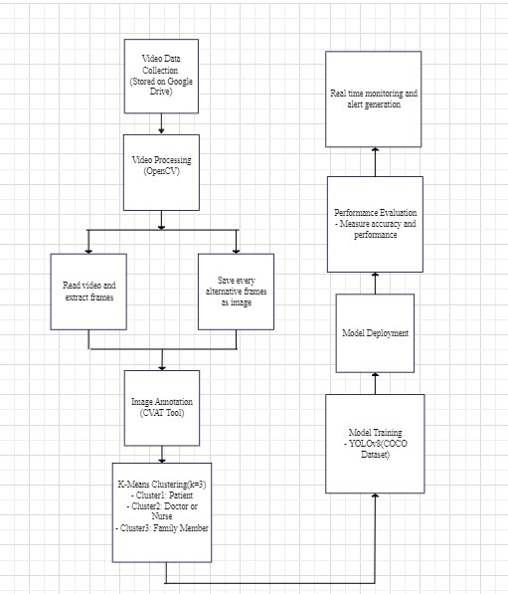
Architecture Diagram

Slide 13
Team Contribution
Vaishnavi(Team Leader):
Clustering and Model Training
Model Deployment
Performance Evaluation
Namrata(Team Member):
Data Acquisition
Preprocessing
Annotation

Slide 14
Conclusion
The Innovative Monitoring System for TeleICU Patients leverages advanced video processing and deep learning techniques to provide continuous, real-time monitoring of ICU patients. By converting video feeds into annotated images and using a series of lightweight, efficient models, the system can accurately detect and classify individuals in the ICU and monitor critical patient movements. This approach ensures timely medical intervention, enhances patient care, and optimizes the use of healthcare resources. With the integration of Google Colab and cloud storage, the system is scalable, adaptable, and ready to be deployed in diverse ICU environments, ultimately improving patient outcomes and supporting healthcare providers in delivering high-quality care.

